Slide 1
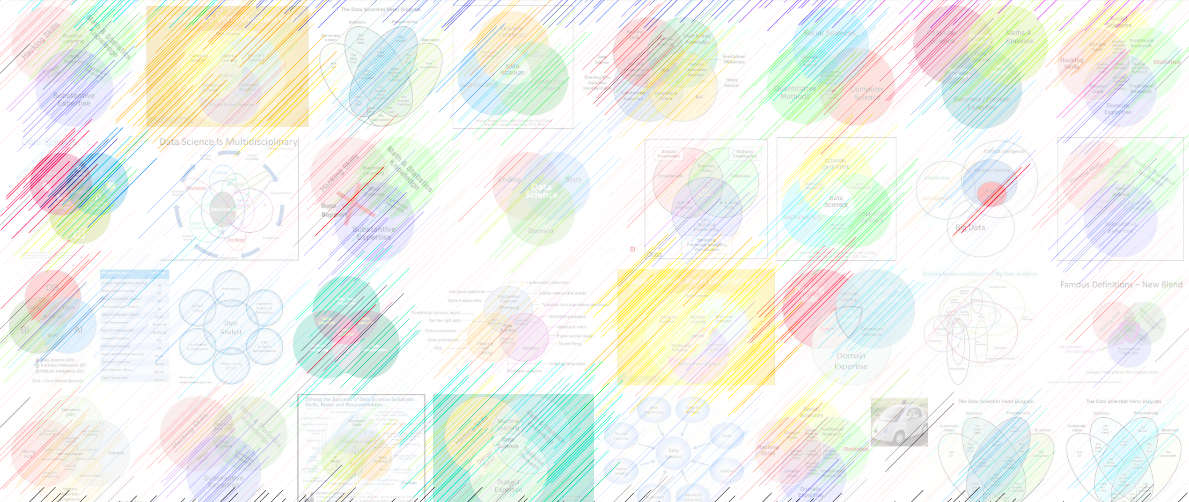

03 entropy, KL divergence,
William Trimble
Spring 2022

Slide 2
Office hours
office hours Wednesday 2pm (Jiacheng, zoom)
office hours Thursday 2pm (Sherry, zoom)
office hours Friday 2pm (WT, Crerar 354 + zoom)
office hours Monday 2-3 (zoom)

Slide 3
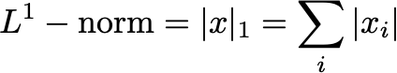
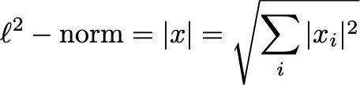
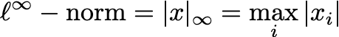
The norm definitions
“norms” always have same units as x!

Slide 4
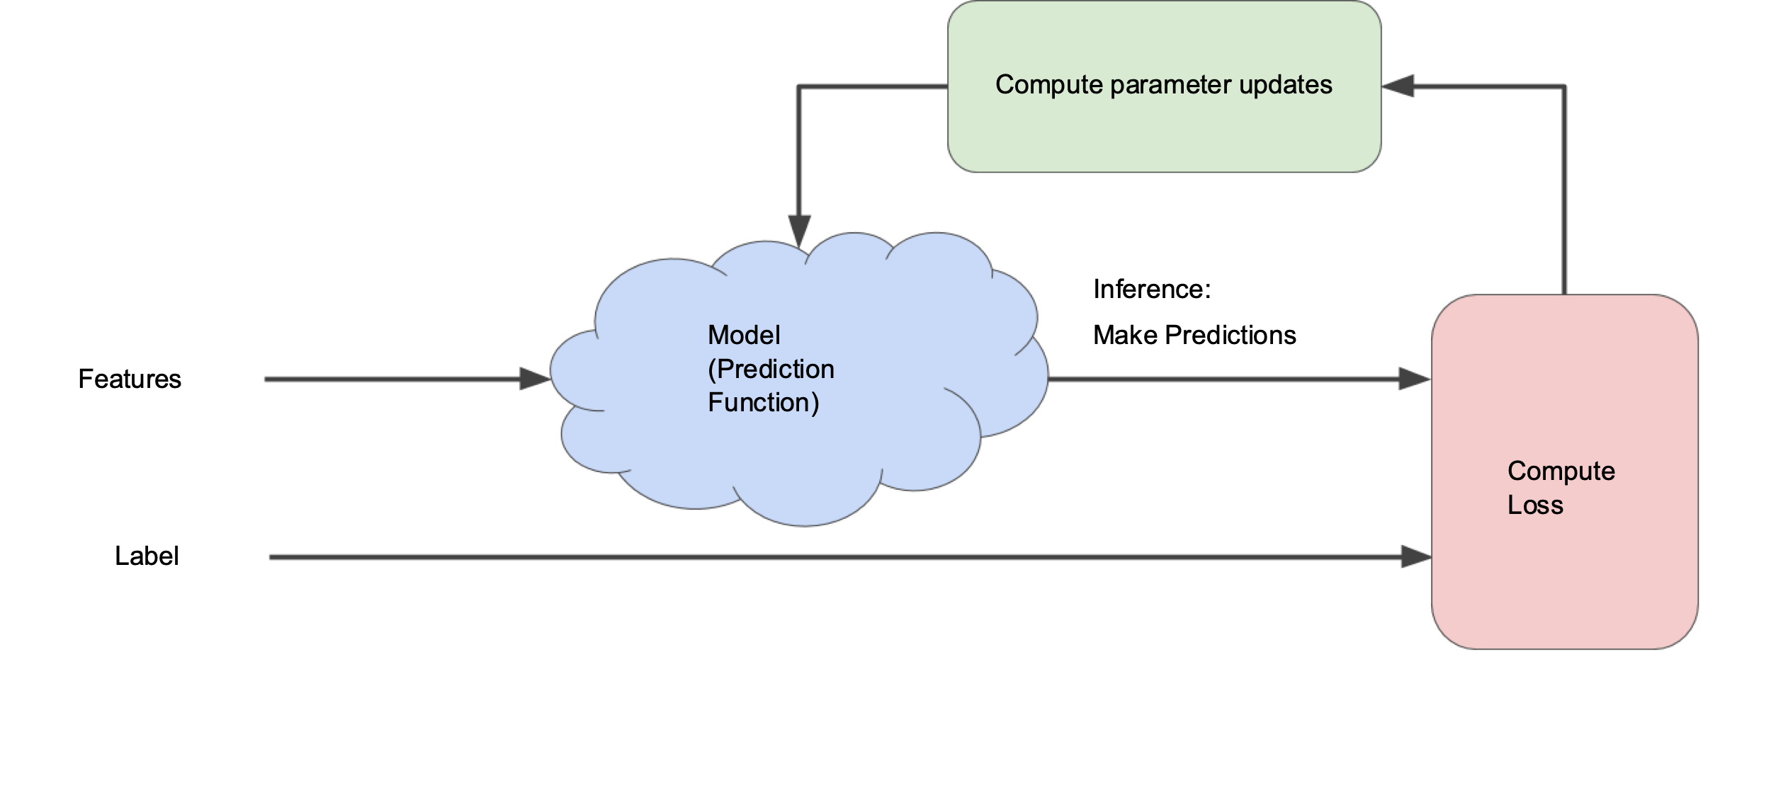
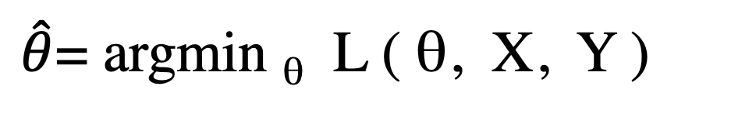
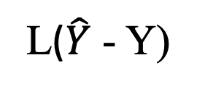

Fairy dust picture of optimization
$\hat{θ}$= argmin _{θ} L ( θ, X, Y )
Loss
θ
$$\hat{Y}$$
X
Y
L($\hat{Y}$ - Y)

Slide 5
Inferring paramters
θ: value of model parameter
Y: training data
P( θ | Y ) = P(Y|θ) P(θ) / P(Y)
Distribution
to help me
find the
parameter value
posterior
This is the
likelihood
likelihood
Y
θ
Prior
distribution
for parameter
prior
Doesn’t
matter for
us
evidence
θ∩Y

Slide 6
Inferring parameters
θ : value of model parameter
Y: training data
log P(θ | Y ) = log P(Y| θ) + log P(θ)
log parameter distribution
The log likelihood
Prior distribution
on the parameter
log prior
log posterior
log likelihood

Slide 7
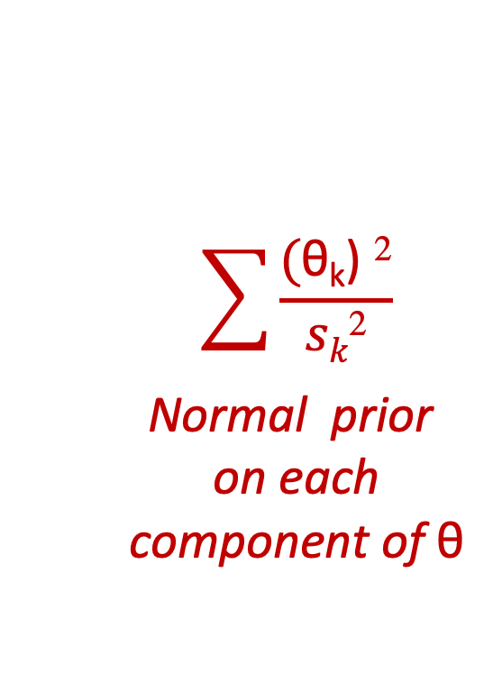
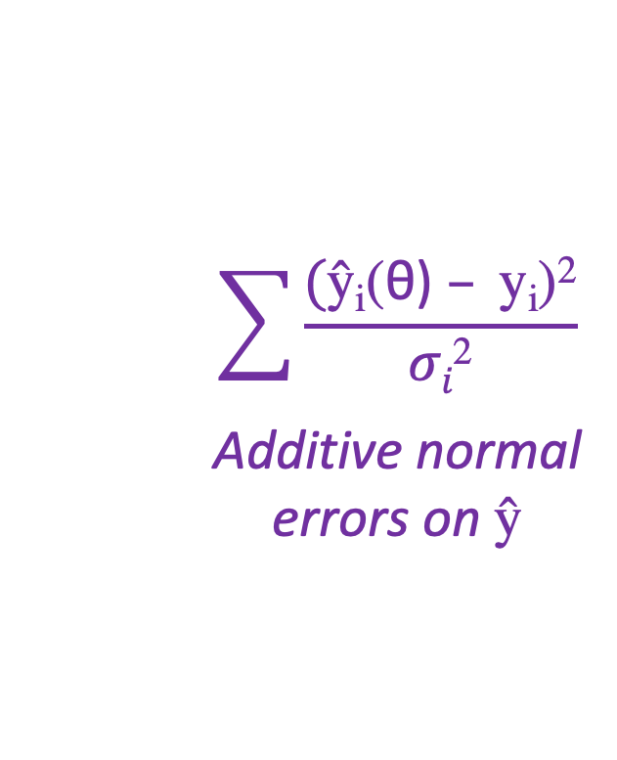
Inferring parameters
θ : value of model parameter
Y: training data
log P( θ | Y ) = log P(Y| θ) + log P(θ)
$$\sum{\frac{\text{(}\text{ŷ}\text{i}\text{(}\text{θ}\text{)} – \text{y}\text{i}\text{)}\text{2}}{σi\text{2}}}$$
Additive normal
errors on $\text{ŷ}$
$$\sum{\frac{\text{(}\text{θ}\text{k}\text{)} \text{2}}{sk\text{2}}}$$
Normal prior
on each
component of $\text{θ}$
L ( θ | Y ) =
log prior
+
log posterior
log likelihood

Slide 8
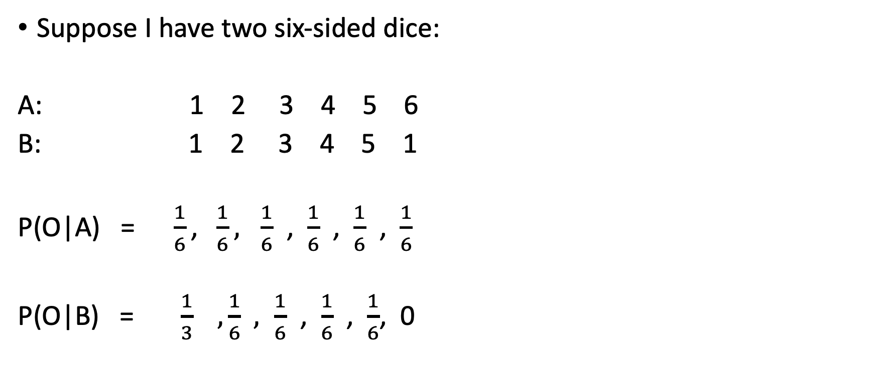
Dice problem
Suppose I have two six-sided dice:
A: 1 2 3 4 5 6
B: 1 2 3 4 5 1
P(O|A) =$\frac{1}{6}\text{, }\frac{1}{6}, \frac{1}{6}$ , $\frac{1}{6}$ , $\frac{1}{6}$ , $\frac{1}{6}$
P(O|B) = $\frac{1}{3} , \frac{1}{6}$ $, \frac{1}{6}$ , $\frac{1}{6}$ , $\frac{1}{6}$, 0

Slide 9
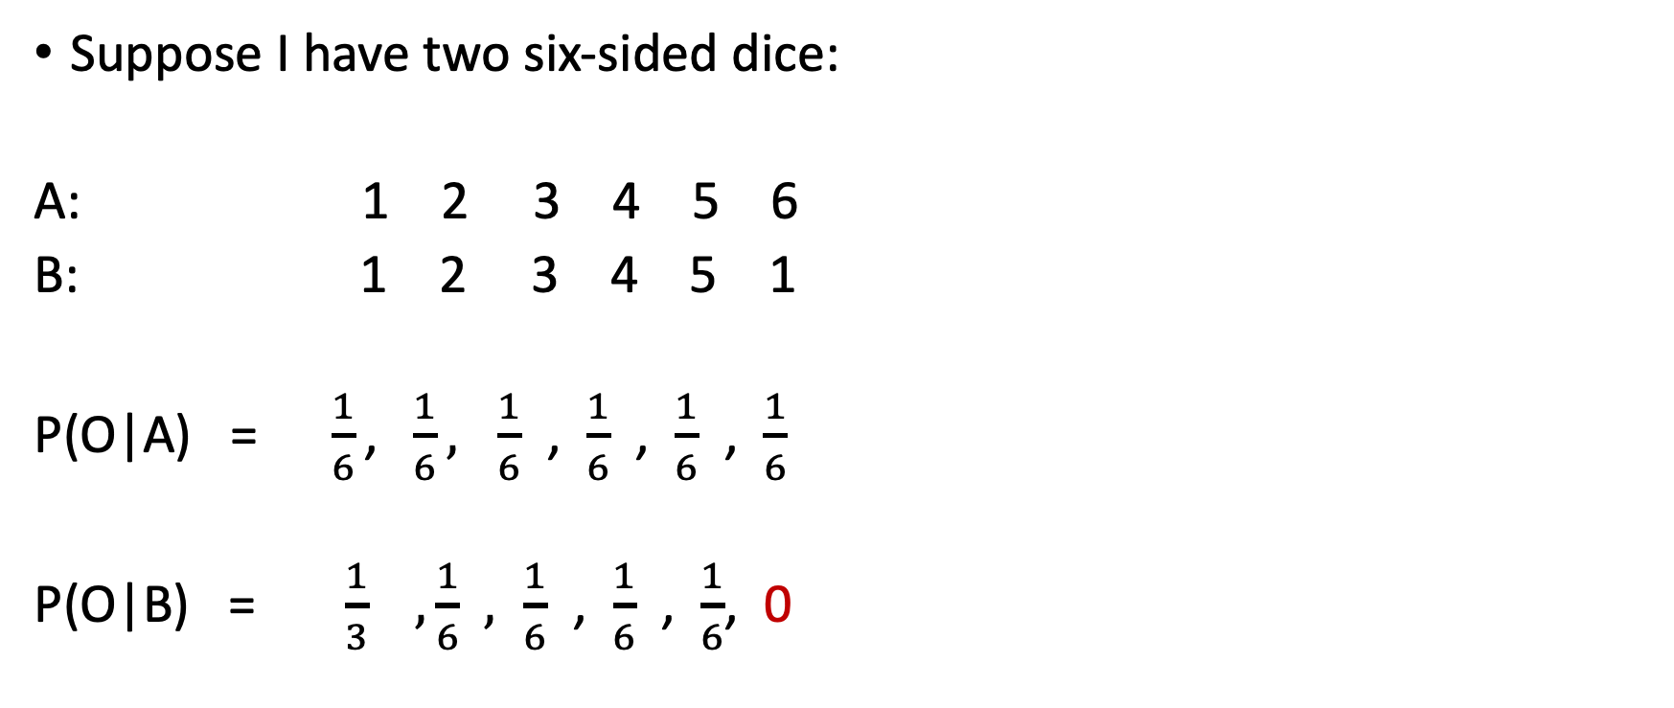
Dice problem
Suppose I have two six-sided dice:
A: 1 2 3 4 5 6
B: 1 2 3 4 5 1
P(O|A) =$\frac{1}{6}\text{, }\frac{1}{6}, \frac{1}{6}$ , $\frac{1}{6}$ , $\frac{1}{6}$ , $\frac{1}{6}$
P(O|B) = $\frac{1}{3} , \frac{1}{6}$ $, \frac{1}{6}$ , $\frac{1}{6}$ , $\frac{1}{6}$, 0
The first time I see a six, the game is over.

Slide 10
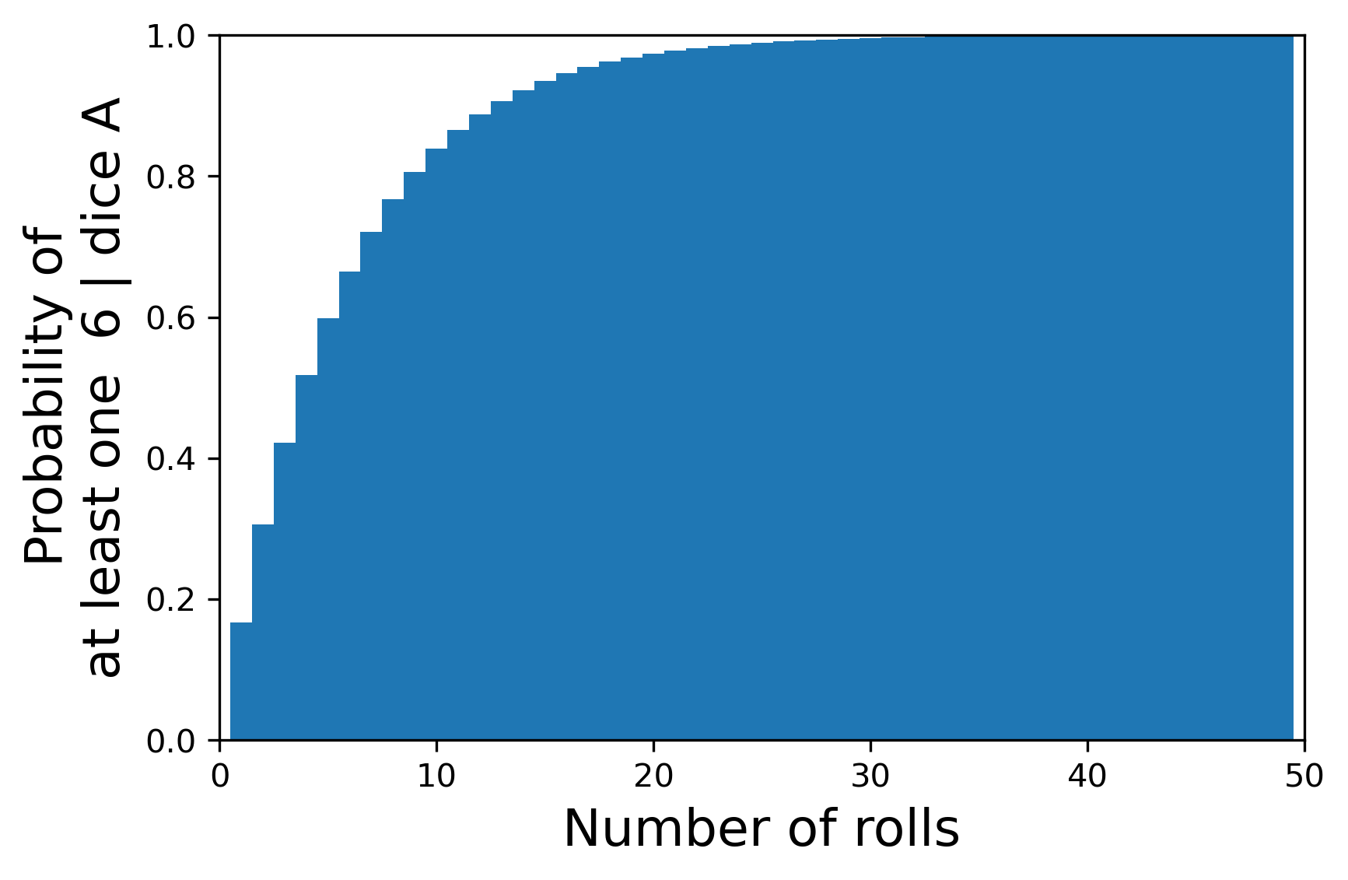
Dice problem
Geometric (k , p=1/6)
Suppose I have two six-sided dice:
A: 1 2 3 4 5 6
B: 1 2 3 4 5 1
P(O|A) =$\frac{1}{6}\text{, }\frac{1}{6}, \frac{1}{6}$ , $\frac{1}{6}$ , $\frac{1}{6}$ , $\frac{1}{6}$
P(O|B) = $\frac{1}{3} , \frac{1}{6}$ $, \frac{1}{6}$ , $\frac{1}{6}$ , $\frac{1}{6}$, 0

Slide 11
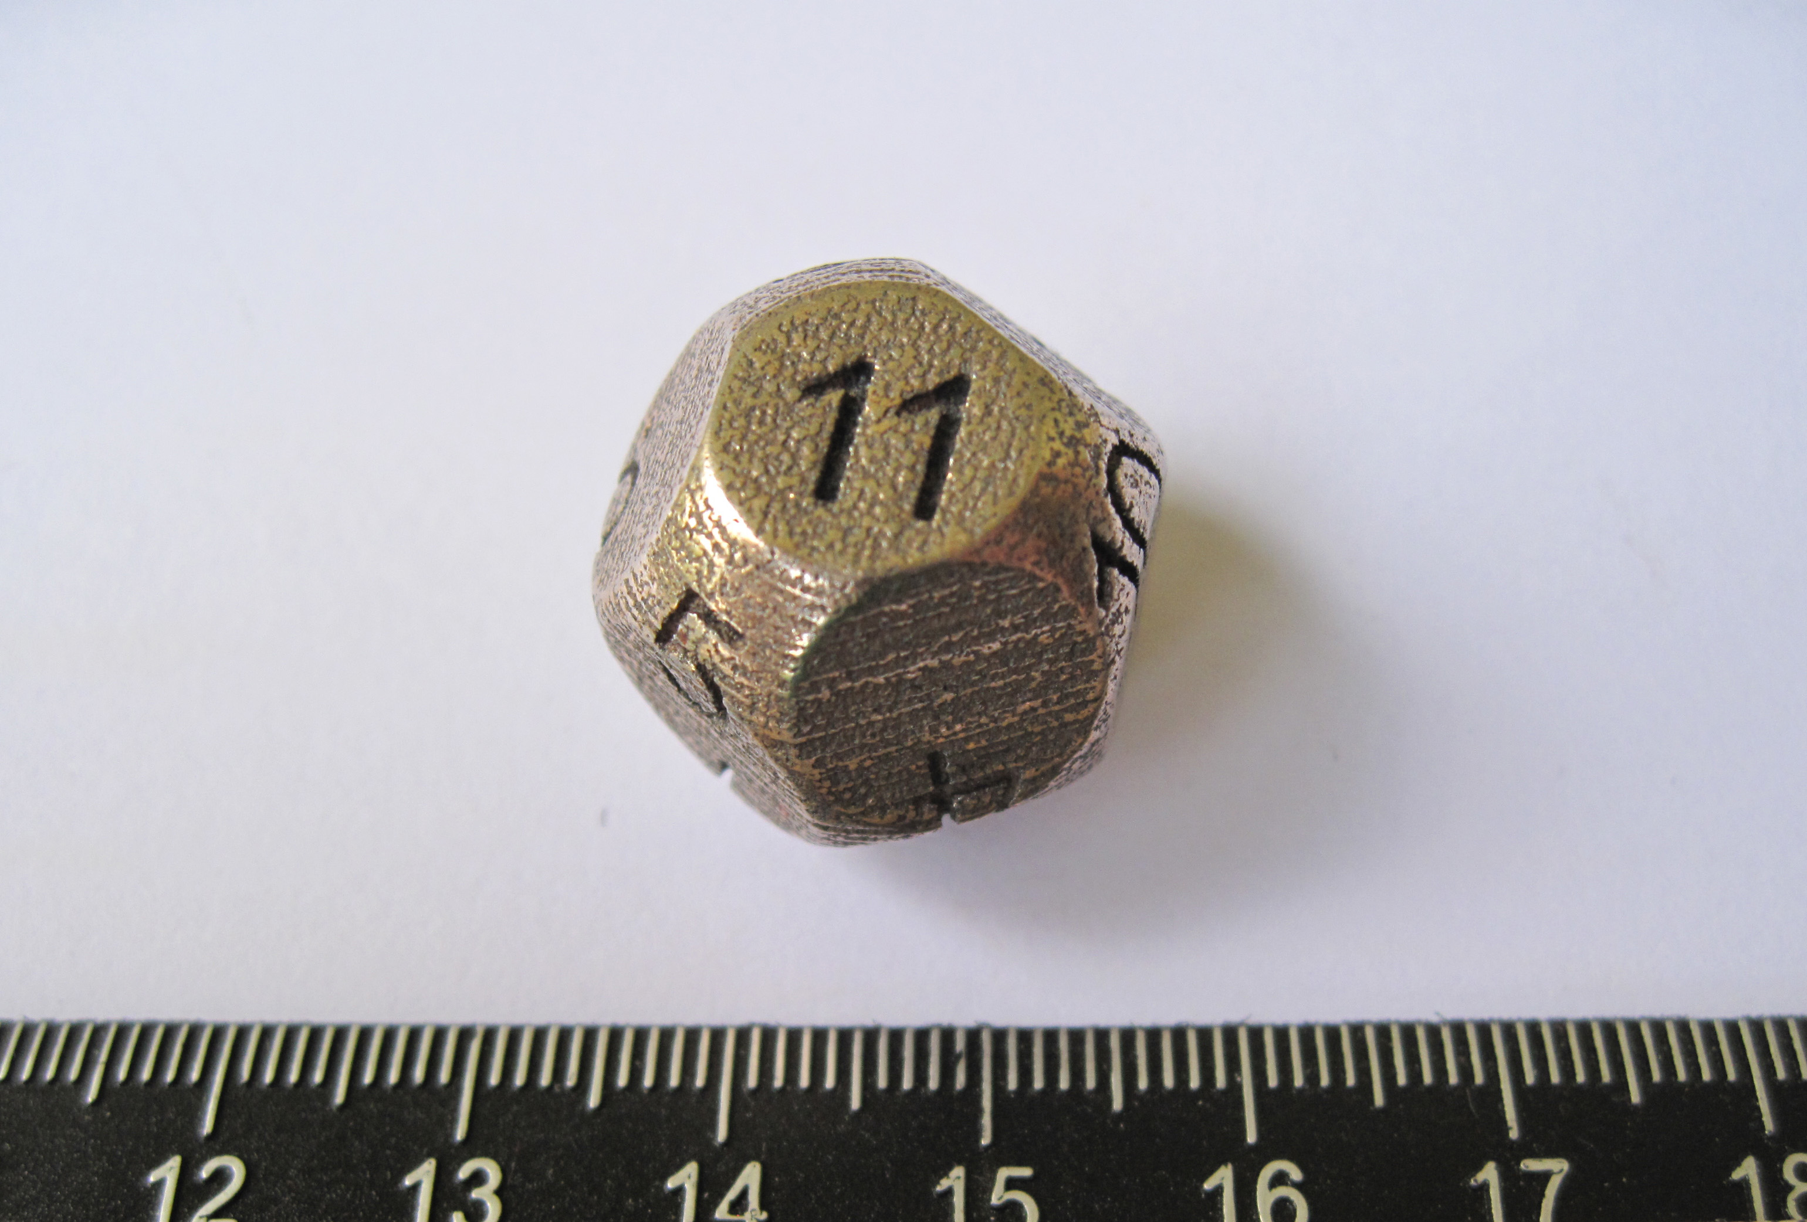
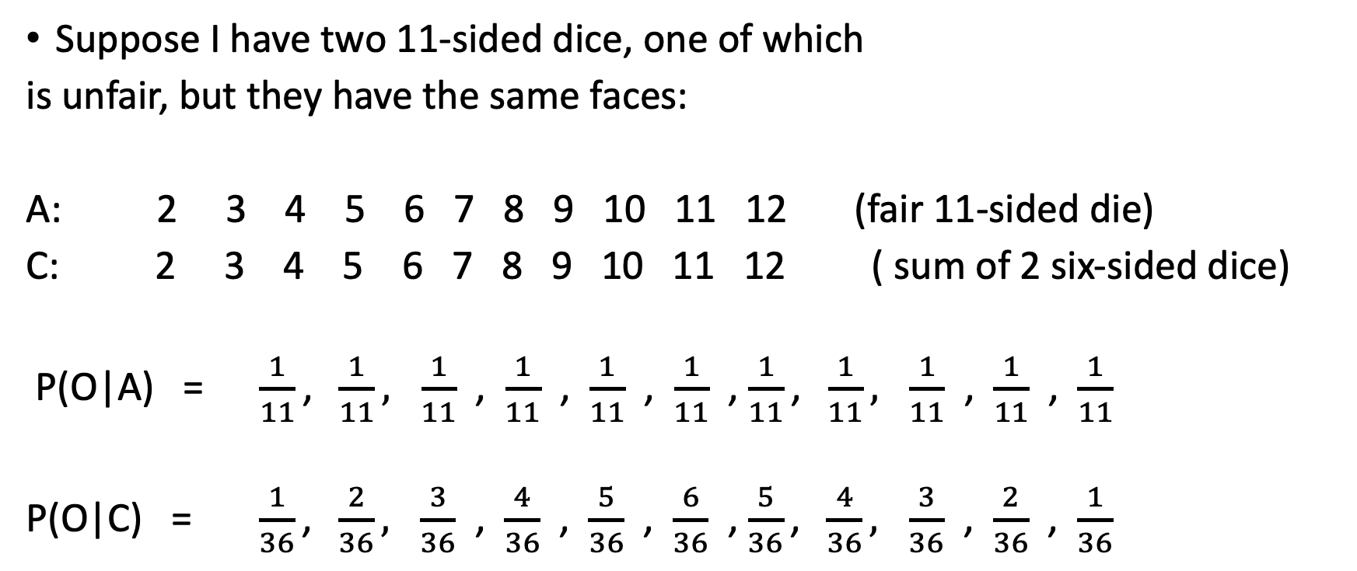
Dice problem
Suppose I have two 11-sided dice, one of which
is unfair, but they have the same faces:
A: 2 3 4 5 6 7 8 9 10 11 12 (fair 11-sided die)
C: 2 3 4 5 6 7 8 9 10 11 12 ( sum of 2 six-sided dice)
P(O|A) =$\frac{1}{11}\text{, }\frac{1}{11}, \frac{1}{11}$ , $\frac{1}{11}$ , $\frac{1}{11}$ , $\frac{1}{11}$ , $\frac{1}{11}\text{, }\frac{1}{11}, \frac{1}{11}$ , $\frac{1}{11}$ , $\frac{1}{11}$
P(O|C) = $\frac{1}{36}\text{, }\frac{2}{36}, \frac{3}{36}$ , $\frac{4}{36}$ , $\frac{5}{36}$ , $\frac{6}{36}$ , $\frac{5}{36}\text{, }\frac{4}{36}, \frac{3}{36}$ , $\frac{2}{36}$ , $\frac{1}{36}$

Slide 12
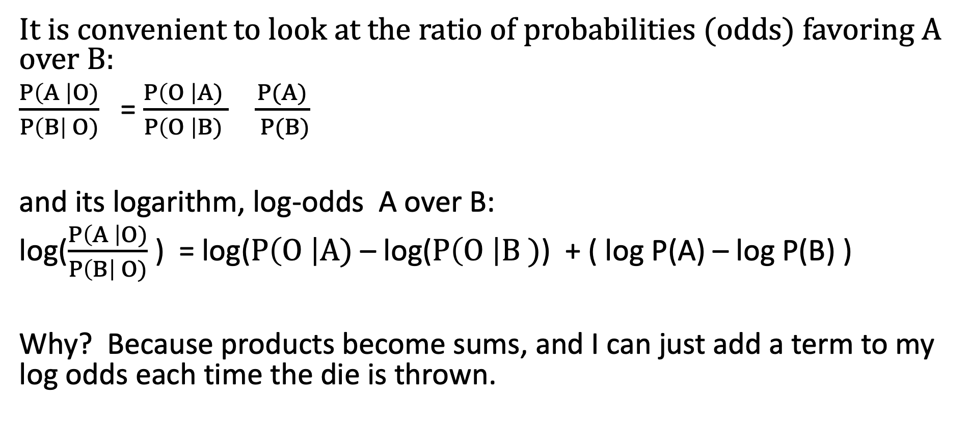
So let’s calculate the odds ratio A:B
It is convenient to look at the ratio of probabilities (odds) favoring A over B:
$\frac{P\left(A \right|O)}{P\left(B\right| O)}$ = $\frac{P\left(O \right|A) }{P\left(O \right|B) } \frac{P(A)}{ P(B)}$
and its logarithm, log-odds A over B:
log($\frac{P\left(A \right|O)}{P\left(B\right| O)}$) = log($P\left(O \right|A)$ – log($P\left(O \right|B )$) + ( log P(A) – log P(B) )
Why? Because products become sums, and I can just add a term to my log odds each time the die is thrown.

Slide 13
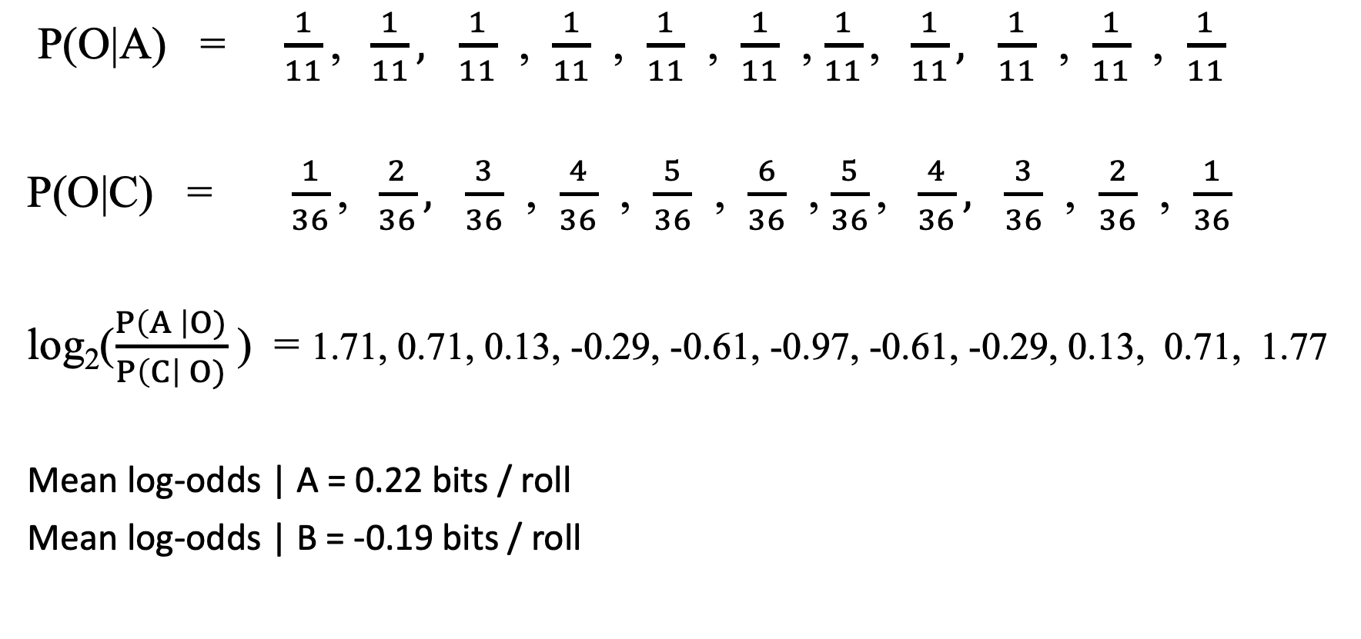
How long will it take?
P(O|A) =$\frac{1}{11}\text{, }\frac{1}{11}, \frac{1}{11}$ , $\frac{1}{11}$ , $\frac{1}{11}$ , $\frac{1}{11}$ , $\frac{1}{11}\text{, }\frac{1}{11}, \frac{1}{11}$ , $\frac{1}{11}$ , $\frac{1}{11}$
P(O|C) = $\frac{1}{36}\text{, }\frac{2}{36}, \frac{3}{36}$ , $\frac{4}{36}$ , $\frac{5}{36}$ , $\frac{6}{36}$ , $\frac{5}{36}\text{, }\frac{4}{36}, \frac{3}{36}$ , $\frac{2}{36}$ , $\frac{1}{36}$
log₂($\frac{P\left(A \right|O)}{P\left(C\right| O)}$) = 1.71, 0.71, 0.13, -0.29, -0.61, -0.97, -0.61, -0.29, 0.13, 0.71, 1.77
Mean log-odds | A = 0.22 bits / roll
Mean log-odds | B = -0.19 bits / roll
log₂ 99 = 6.63 bits (threshold 99:1)

Slide 14
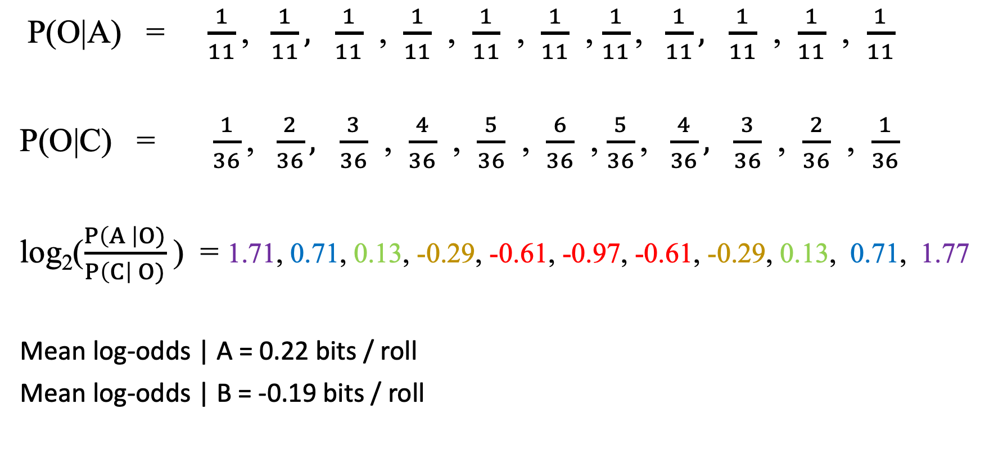
How long will it take?
P(O|A) =$\frac{1}{11}\text{, }\frac{1}{11}, \frac{1}{11}$ , $\frac{1}{11}$ , $\frac{1}{11}$ , $\frac{1}{11}$ , $\frac{1}{11}\text{, }\frac{1}{11}, \frac{1}{11}$ , $\frac{1}{11}$ , $\frac{1}{11}$
P(O|C) = $\frac{1}{36}\text{, }\frac{2}{36}, \frac{3}{36}$ , $\frac{4}{36}$ , $\frac{5}{36}$ , $\frac{6}{36}$ , $\frac{5}{36}\text{, }\frac{4}{36}, \frac{3}{36}$ , $\frac{2}{36}$ , $\frac{1}{36}$
log₂($\frac{P\left(A \right|O)}{P\left(C\right| O)}$) = 1.71, 0.71, 0.13, -0.29, -0.61, -0.97, -0.61, -0.29, 0.13, 0.71, 1.77
Mean log-odds | A = 0.22 bits / roll
Mean log-odds | B = -0.19 bits / roll
log₂ 99 = 6.63 bits (threshold 99:1)
6.63 bits / 0.22 bits / roll = 30.2 rolls |A
6.63 bits / 0.19 bits / roll = 35.8 rolls |B

Slide 15
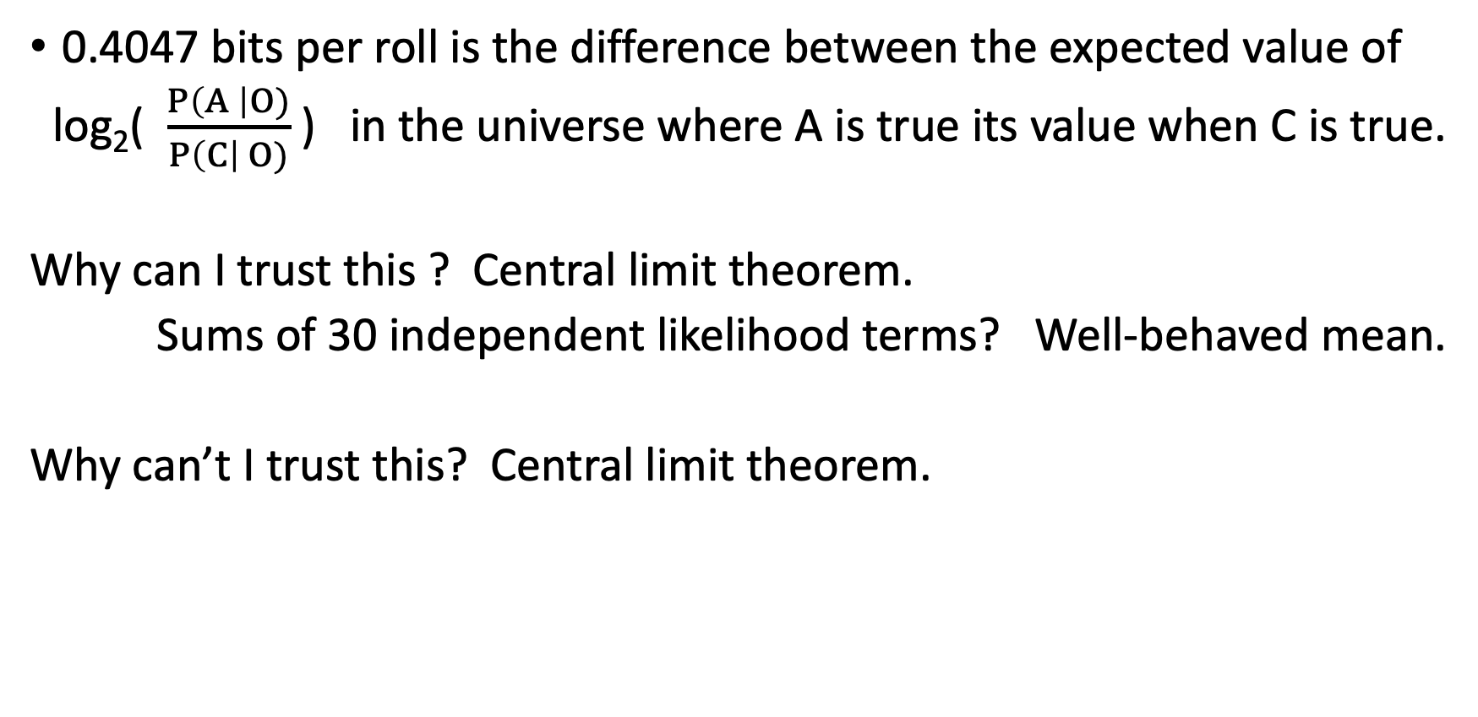
Wait, what assumptions did I make here?
0.4047 bits per roll is the difference between the expected value of
log₂( $\frac{P\left(A \right|O)}{P\left(C\right| O)}$) in the universe where A is true its value when C is true.
Why can I trust this ? Central limit theorem.
Sums of 30 independent likelihood terms? Well-behaved mean.
Why can’t I trust this? Central limit theorem.

Slide 16
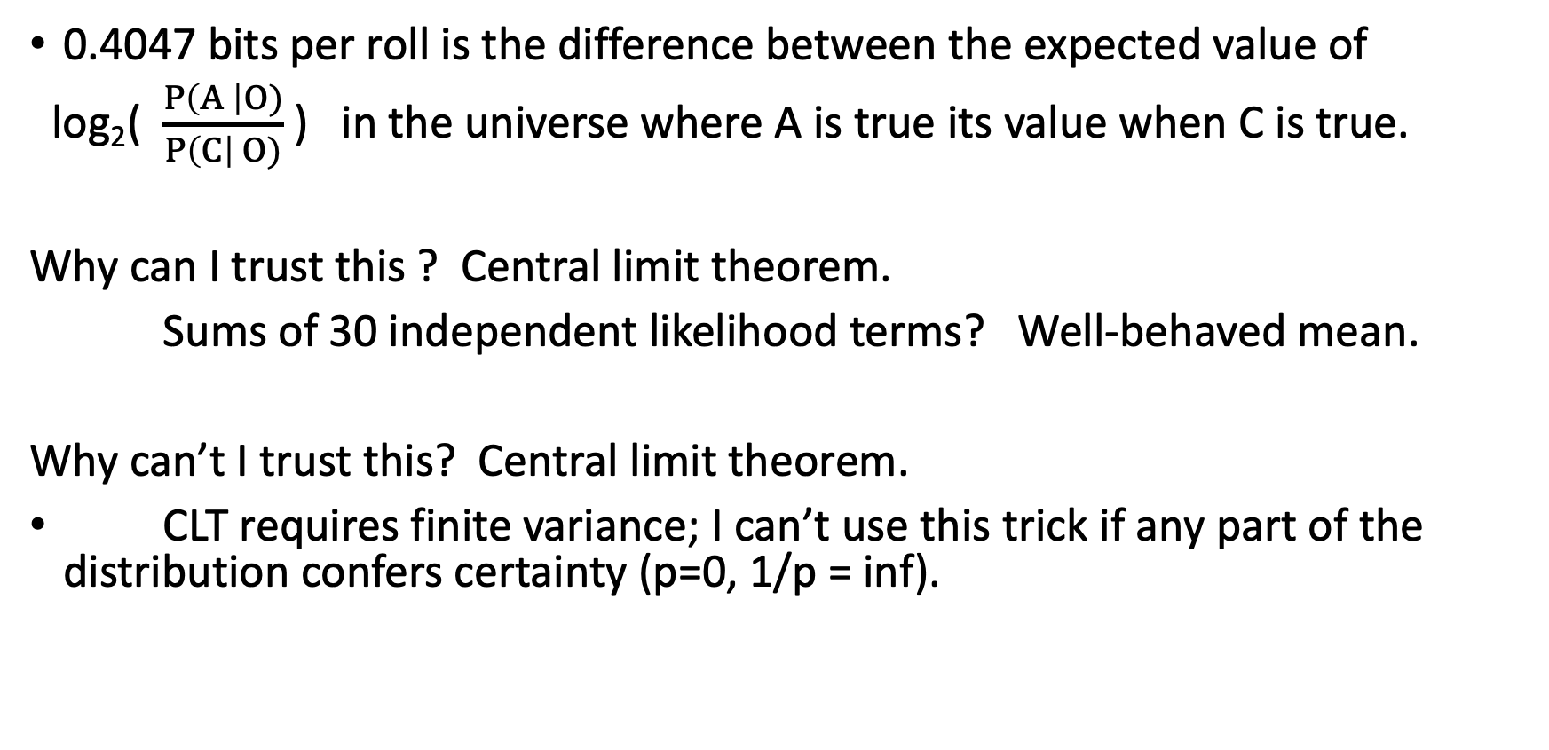
Wait, what assumptions did I make here?
0.4047 bits per roll is the difference between the expected value of
log₂( $\frac{P\left(A \right|O)}{P\left(C\right| O)}$) in the universe where A is true its value when C is true.
Why can I trust this ? Central limit theorem.
Sums of 30 independent likelihood terms? Well-behaved mean.
Why can’t I trust this? Central limit theorem.
CLT requires finite variance; I can’t use this trick if any part of the distribution confers certainty (p=0, 1/p = inf).

Slide 17
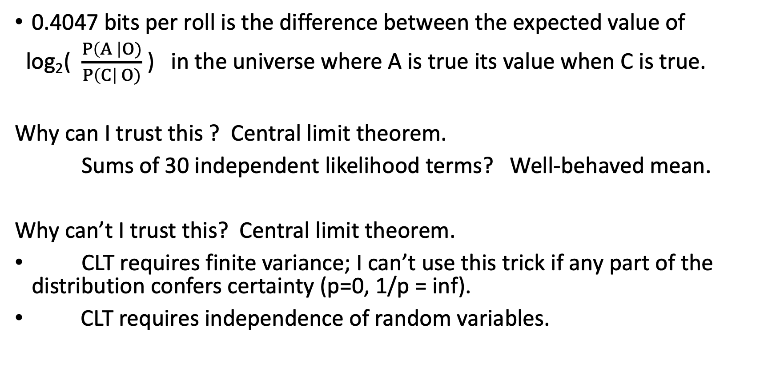
Wait, what assumptions did I make here?
0.4047 bits per roll is the difference between the expected value of
log₂( $\frac{P\left(A \right|O)}{P\left(C\right| O)}$) in the universe where A is true its value when C is true.
Why can I trust this ? Central limit theorem.
Sums of 30 independent likelihood terms? Well-behaved mean.
Why can’t I trust this? Central limit theorem.
CLT requires finite variance; I can’t use this trick if any part of the distribution confers certainty (p=0, 1/p = inf).
CLT requires independence of random variables.

Slide 18
Dice problem
Geometric (k , p=1/6)
Suppose I have two six-sided dice:
A: 1 2 3 4 5 6
B: 1 2 3 4 5 1
P(O|A) =$\frac{1}{6}\text{, }\frac{1}{6}, \frac{1}{6}$ , $\frac{1}{6}$ , $\frac{1}{6}$ , $\frac{1}{6}$
P(O|B) = $\frac{1}{3} , \frac{1}{6}$ $, \frac{1}{6}$ , $\frac{1}{6}$ , $\frac{1}{6}$, 0

Slide 19
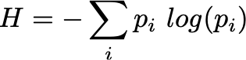
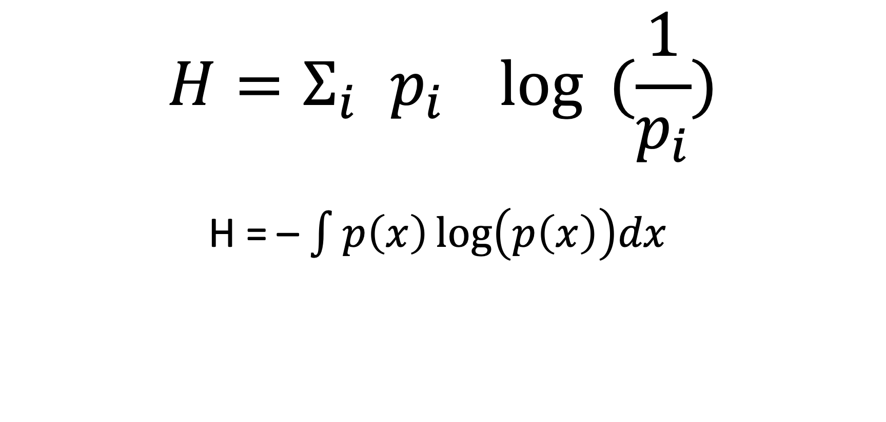
Entropy – discrete forumulation
Expected value of the –log probability
$$H=Σ_{i }p_{i}\log{ (\frac{1}{p_{i}})}$$
H = – $\int{p\left(x\right)\log\left(p\left(x\right)\right)dx }$

Slide 20
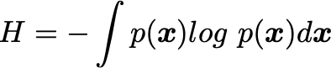
Entropy – continuous formulation
Expected value of the –log probability

Slide 21
Entropy – parts of the definition
Expected value
log – entropies of independent events additive
negative – probabilities are all < 1; logs of all these probabilities are < 0; convention makes low-probabilities high entropy and high probabilities low-entropy.
letter freq p -log(p)
a 0.0575 4.13
b 0.0128 6.28
c 0.0263 5.25
j 0.0006 10.70
d 0.0285 5.13
e 0.0913 3.45

Slide 22
Entropy
Entropy is a property of a probability distribution (or of an element within a probability distribution, like an outcome) that describes how concentrated the distribution is.

Slide 23
Properties of entropy
If all of the probability is in one point, H = 0
Bernoulli distribution: entropy is maximum at p=0.5
Uniform categorical distribution {1/n, 1/n … 1/n} has entropy log n
Watch out for reporting entropy; logarithms have “units” that communicate the base of the log. log10 “ban” log 2 “bits” natural log “nats” Antilog entropy (sometimes called “perplexity”) doesn’t have that problem, since it’s a unitless number.
We will need this to characterize our distribution and compare it to others.

Slide 24
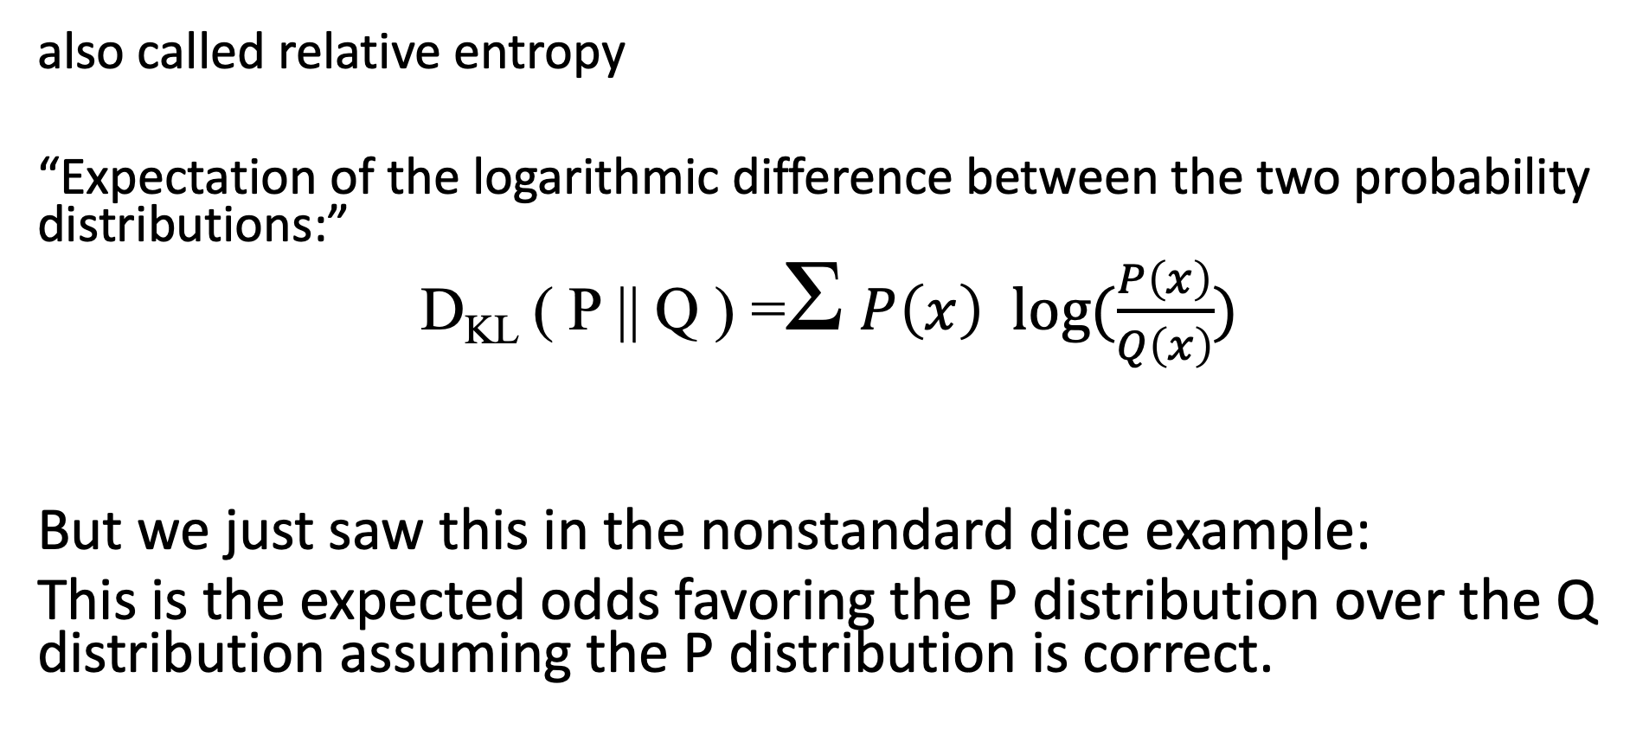
Kullback-Leibler divergence
also called relative entropy
“Expectation of the logarithmic difference between the two probability distributions:”
D_{KL} ( P || Q ) =Σ $P\left(x\right) log⁡(\frac{P\left(x\right)}{Q\left(x\right)})$
But we just saw this in the nonstandard dice example:
This is the expected odds favoring the P distribution over the Q distribution assuming the P distribution is correct.

Slide 25
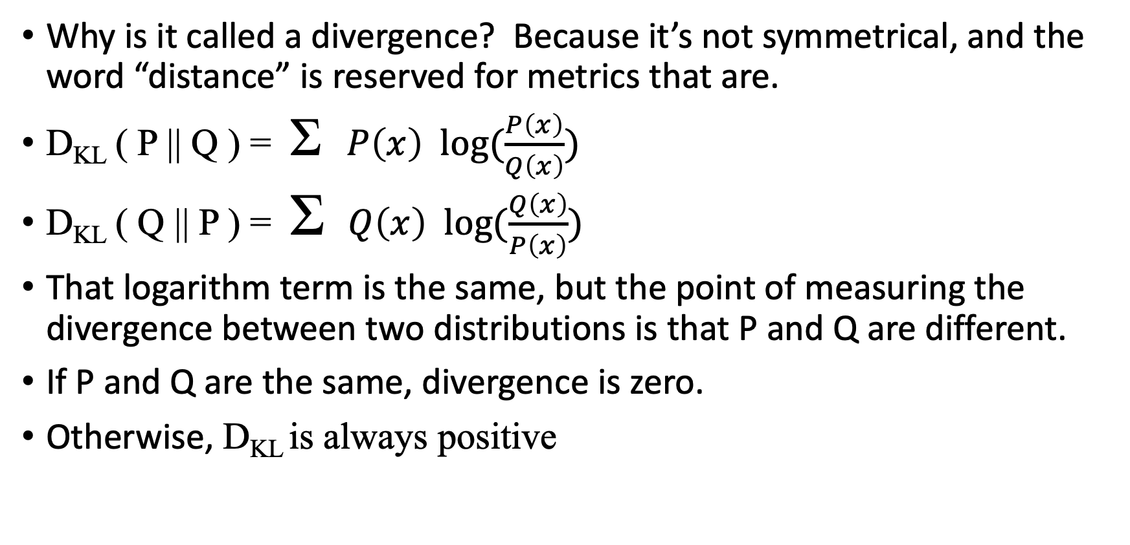
Properties of the Kullback-Liebler divergence
Why is it called a divergence? Because it’s not symmetrical, and the word “distance” is reserved for metrics that are.
D_{KL} ( P || Q ) = Σ$P\left(x\right) log⁡(\frac{P\left(x\right)}{Q\left(x\right)})$
D_{KL} ( Q || P ) = Σ $Q\left(x\right) log⁡(\frac{Q\left(x\right)}{P\left(x\right)})$
That logarithm term is the same, but the point of measuring the divergence between two distributions is that P and Q are different.
If P and Q are the same, divergence is zero.
Otherwise, D_{KL} is always positive

Slide 26
So about that K-L divergence asymmetry…
But we saw an asymmetry with the dice:
There was different qualitative behavior between the two true states of the dice:
The die with only 5 different sides causes odds to accrue slowly
The six-sided die will stumble into infinite odds in favor after an average of 6 rolls.
Doesn’t handle 0 probability elegantly; the infinite negative logarithm makes the expected value infinite, which is inconvenient.
There is a symmetrized version that satisfies the triangle inequality, goes by the name Jensen-Shannon divergence if you need it. It imagines an equal mixture model of P and Q.

